Slide 1
Air line Customer Satisfaction analysis

Slide 3
TABLE OF CONTENTS
01
02
Problem Statement
Project Pipeline
03
04
Analysis and Solution of the Problem
Observations and Insights
05
Model Training and Evaluation
06
Unsuccessful Trials

Slide 4
Problem Statement
Due to aggressive competition in the airline industry, airline companies need to focus on passenger satisfaction. And customer feedback is critical since it is a consequence measurement for business performance.
The purpose of this notebook is to examine how Airlines can aim to determine the importance of each feature with regards to their contribution to passenger satisfaction, and in turn, boost their brand image and their customers’ loyalty and engagement by leveraging customer expectation.

Slide 5
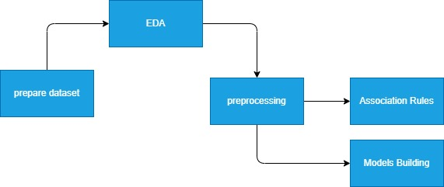
Project Pipeline

Slide 6
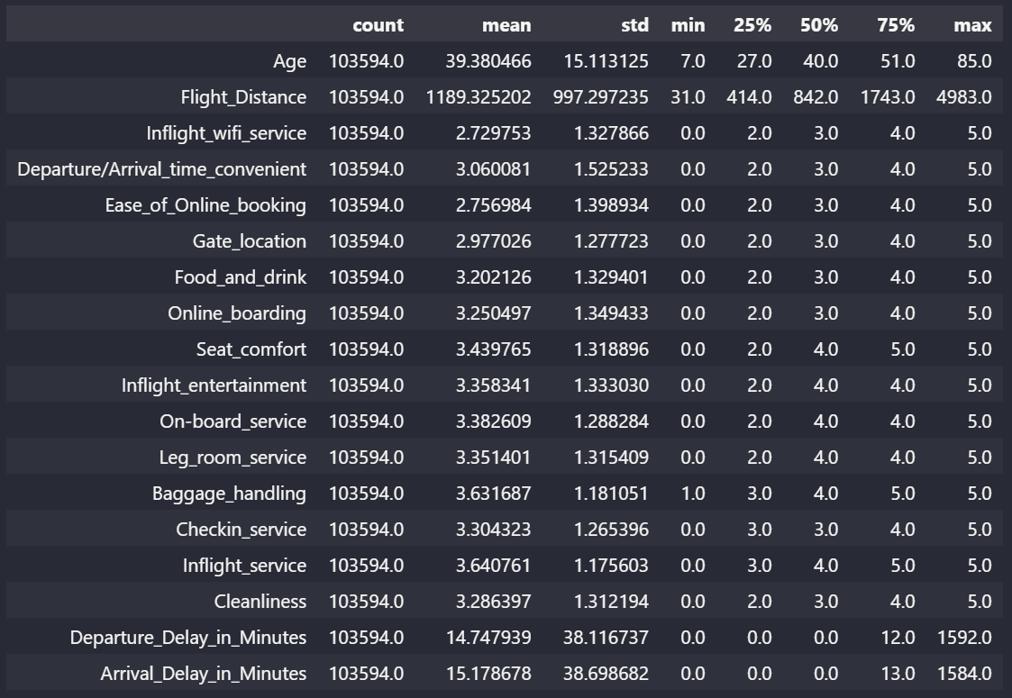
Analysis and Solution of the Problem
Prepare dataset
Collecting Dataset .
Replacing Nan and null values from columns with column mean .
EDA , Observations and Insights
Data Description:

Slide 7
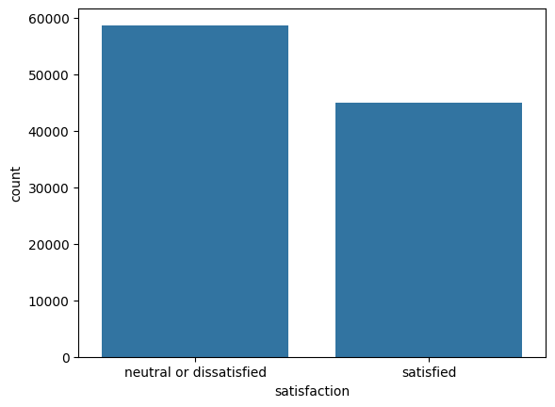
Analysis and Solution of the Problem
from this appears that we have to improve our services in order to make customers more satisfied

Slide 8
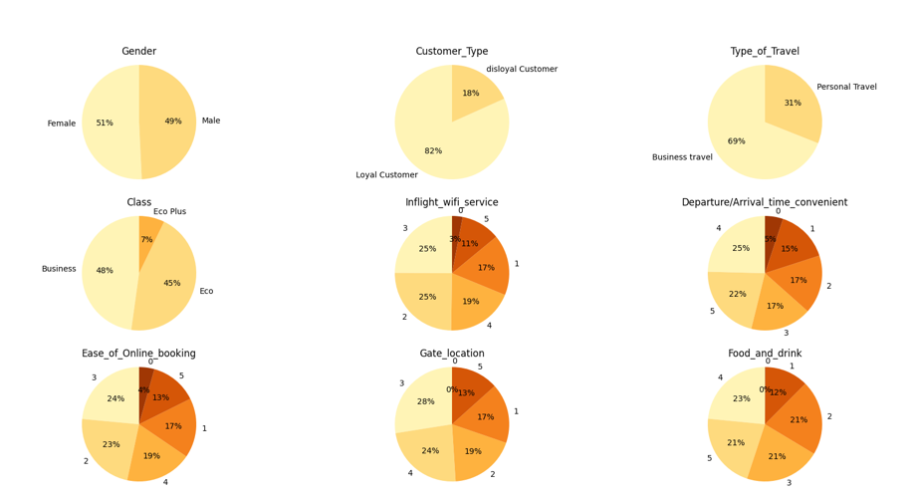
Analysis and Solution of the Problem
Pie chart for each feature to know its distribution:

Slide 9
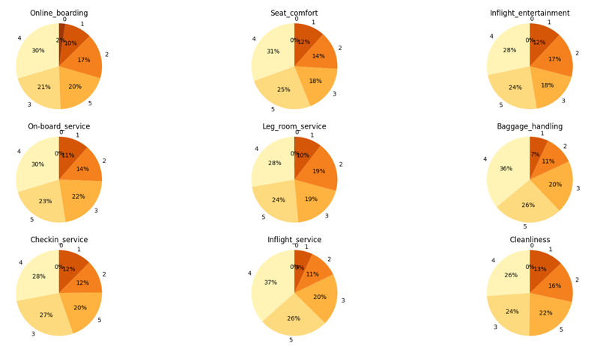
Analysis and Solution of the Problem
Pie chart for each feature to know its distribution:

Slide 10
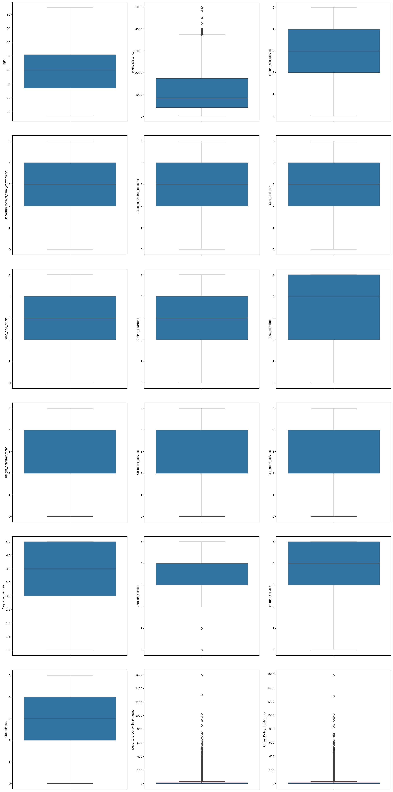
Analysis and Solution of the Problem
2.Box Plot for each feature:

Slide 11
Analysis and Solution of the Problem
2.Box Plot for each feature:
It can be seeing that the delay time minutes exists so many outliers.
Generally, passenger satisfy with the baggage handling and inflight service where the score ranges from 3 to 5 while others mainly stay within 2 to 4 scores.

Slide 12
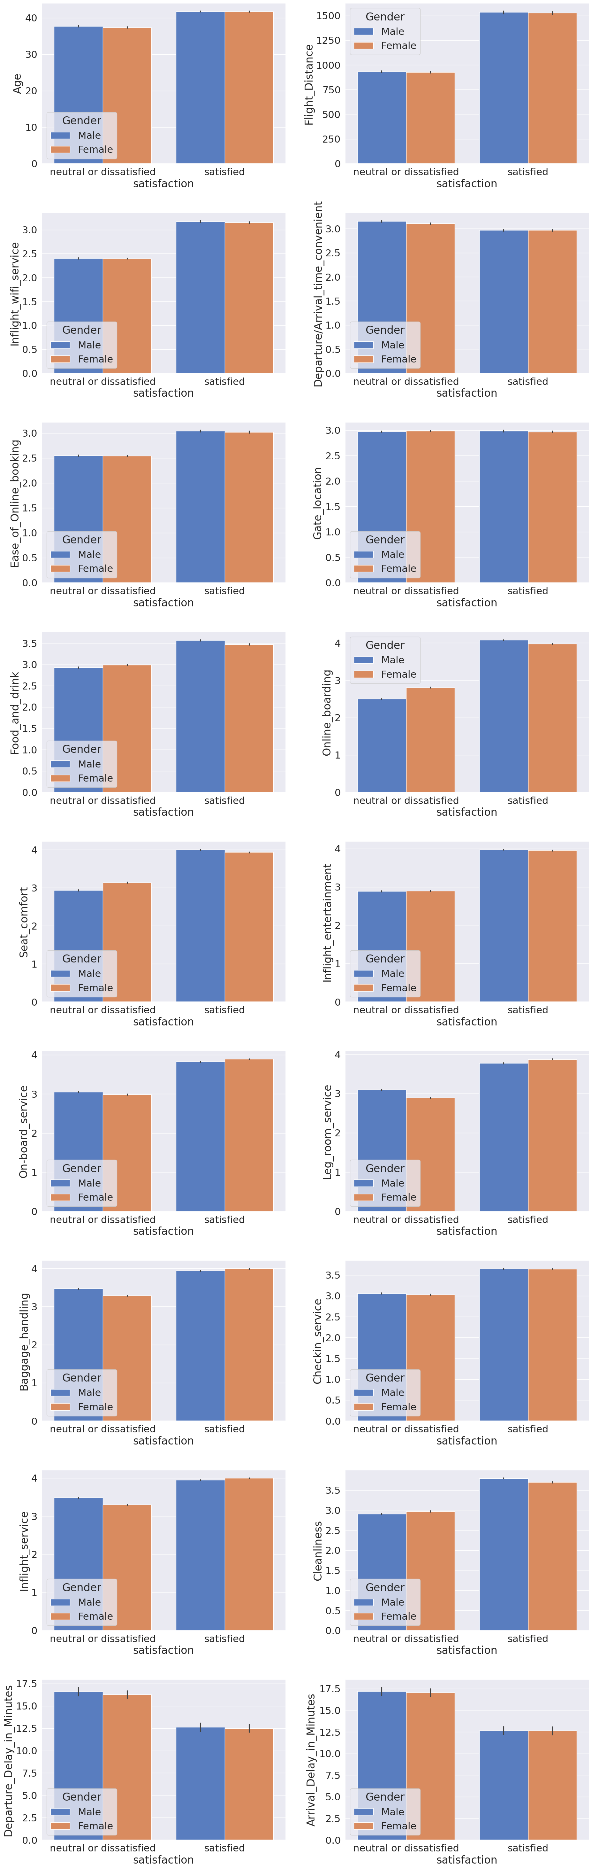
Analysis and Solution of the Problem
3. BarPlot based on some important features:
We compare customer features with services of air line features in order to know level of satisfaction of customer type about our sevice .

Slide 13
Analysis and Solution of the Problem
3. BarPlot based on some important features:
The long flight distance make them more likely to satisfy the trip.
But in average of delay time, they may not satisfy when time is 12.5 mins above.
Between the male and female, there are no significant patterns.
so this column or the information of if the customer male or female is not important as both have almost same pattern .

Slide 14
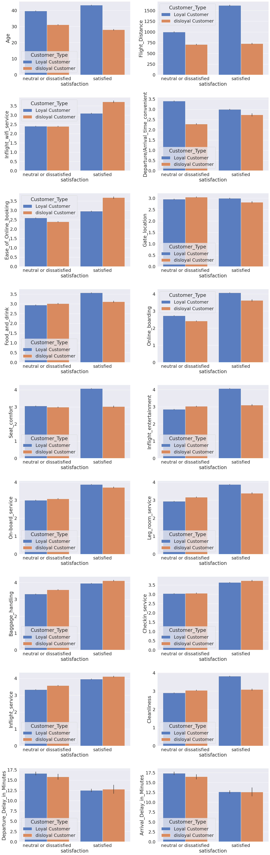
Analysis and Solution of the Problem
3. BarPlot based on some important features:

Slide 15
Analysis and Solution of the Problem
3. BarPlot based on some important features:
For loyal customer:
Age around 40:
Satisfy on high flight distance,seat comfort, inflight entertainment, cleanliness,leg room service,chekin service,baggaging service
For disloyal customer:
Age around 30:
Satisfy on Inflight wifi service, ease of online booking,online boarding,on board service ,chekin service
Again, they generally feel neutral or dissatisfied when the delay time minutes is 12.5 or above

Slide 16
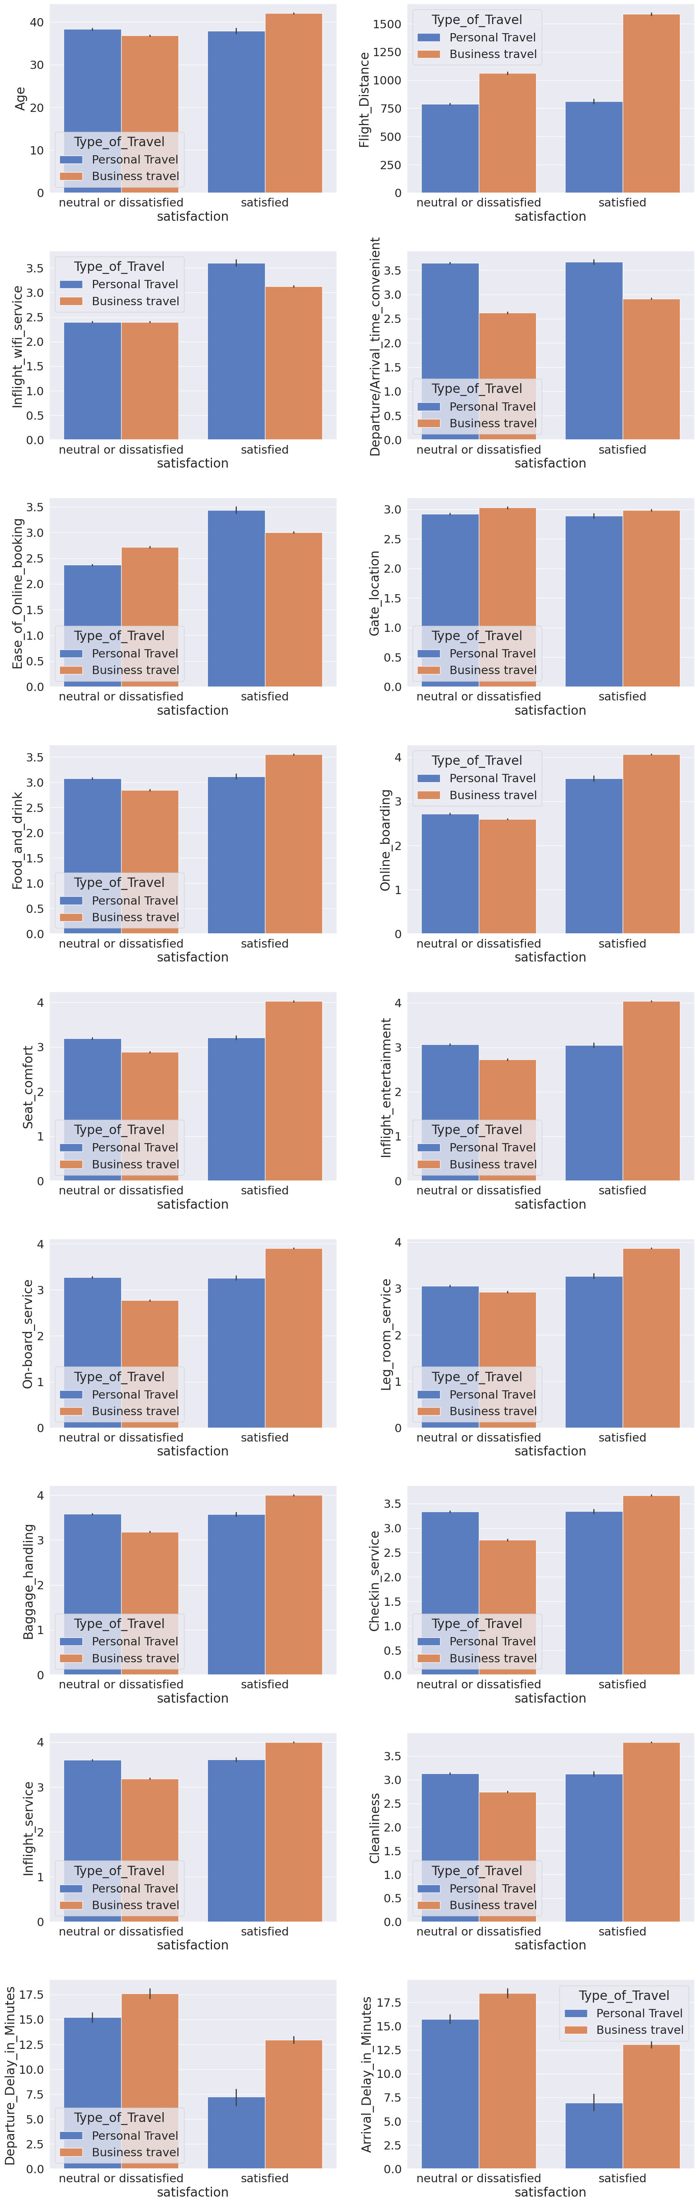
Analysis and Solution of the Problem
3. BarPlot based on some important features:

Slide 17
Analysis and Solution of the Problem
3. BarPlot based on some important features:
Business travel:
satisfaction increase on long flight distance,online boarding,seat comfort,inflight entertaiment,on board service,food and drink almost all features except gate location .
they generally feel neutral or dissatisfied when the delay time minutes is 12.5 or above .
Personal travel:
satisfaction increase on inflight wifi service,ease of online booking,online boarding
they generally feel neutral or dissatisfied when the delay time minutes is almost below 7.5 or above .

Slide 18
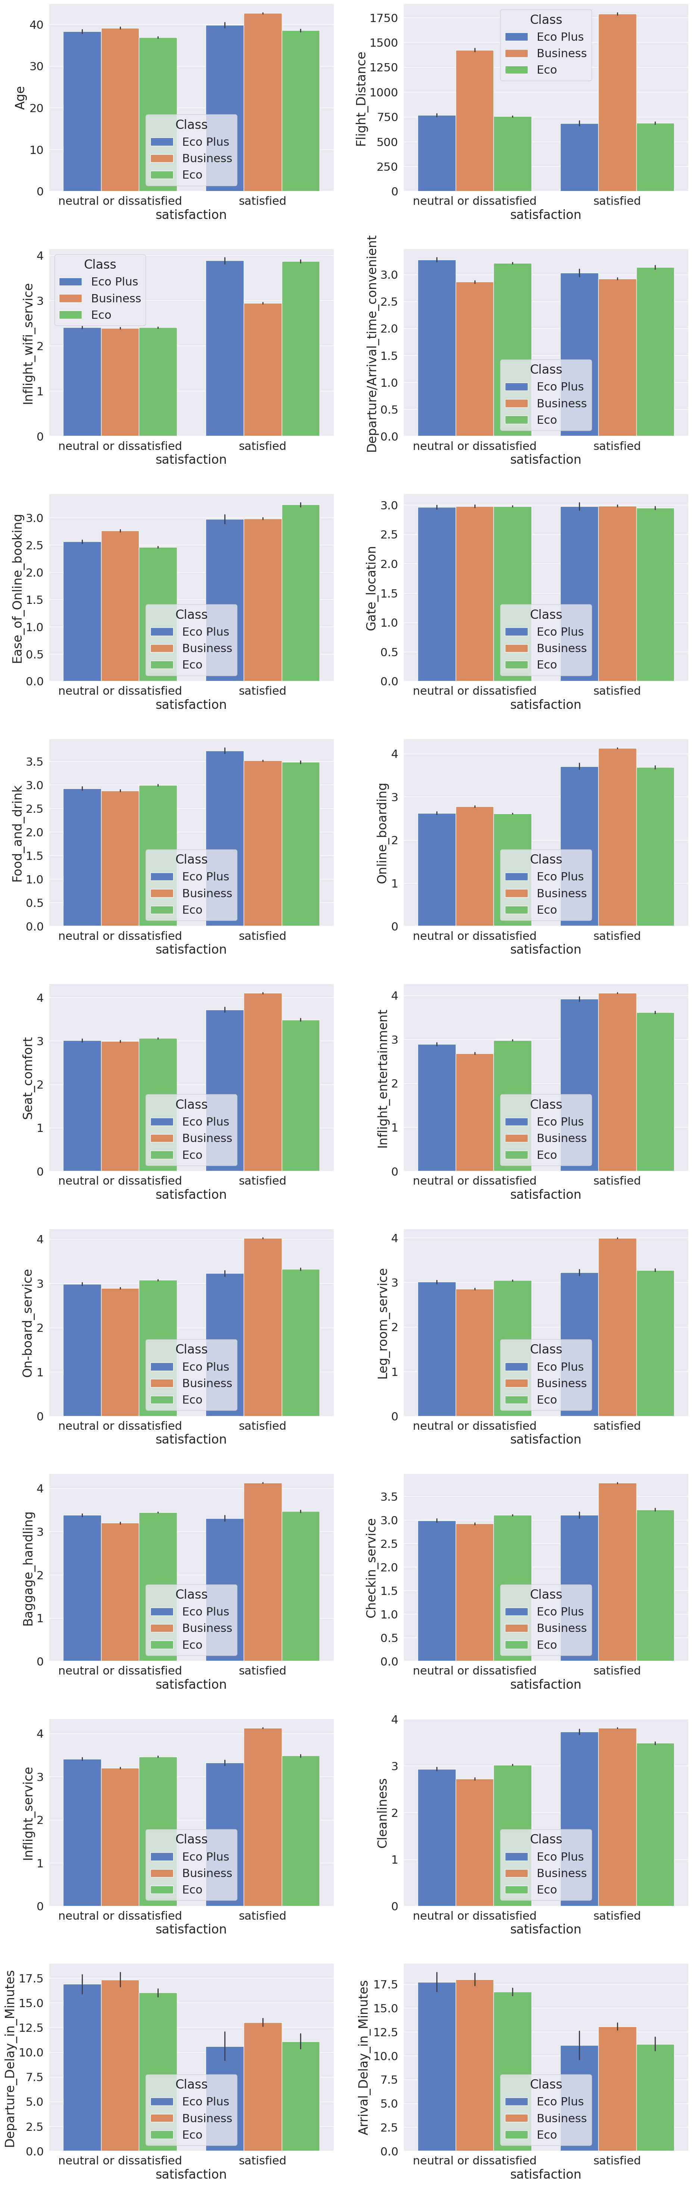
Analysis and Solution of the Problem
3. BarPlot based on some important features:

Slide 19
Analysis and Solution of the Problem
3. BarPlot based on some important features:
- Business Class:
satisfaction increase on long flight distance,inflight wifi service,inflight service,online boarding,seat comfort,inflight entertaiment,on board service,food and drink almost all features except gate location,ease of online booking and arrival time
they generally feel neutral or dissatisfied when the delay time minutes is 12.5 or above
Eco:
all features except long flight distance,gate location,checkin services,baggage handling,inflight service and arrival time
they generally feel neutral or dissatisfied when the delay time minutes is 11.25 or above
Eco Pluse:
satisfaction increase on inflight wifi service,online boarding,seat comfort,inflight entertaiment,on board service,food and drink ,ease of online booking .
they generally feel neutral or dissatisfied when the delay time minutes is 11 or above .

Slide 20
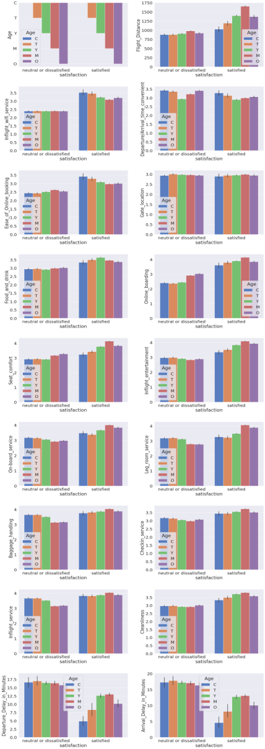
Analysis and Solution of the Problem
3. BarPlot based on some important features:

Slide 21
Analysis and Solution of the Problem
3. BarPlot based on some important features:
child:they generally feel neutral or dissatisfied when the delay time minutes is 4 or above
teenager:they generally feel neutral or dissatisfied when the delay time minutes is 8 or above
youth:
they generally feel neutral or dissatisfied when the delay time minutes is 12.5 or above
middle age:
satisfied most by long flight deistance more tha 1000
they generally feel neutral or dissatisfied when the delay time minutes is 13 or above
old:
they generally feel neutral or dissatisfied when the delay time minutes is 10 or above
for all satisfaction increase on long flight distance,inflight wifi service,online boarding,seat comfort,inflight entertaiment,on board service,food and drink almost all features except gate location and arrival time

Slide 22
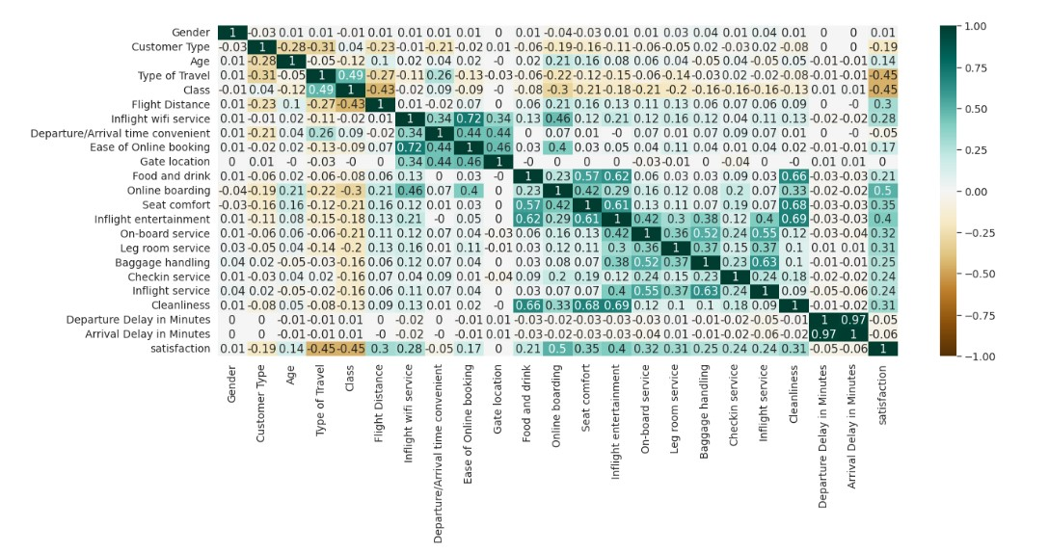
Analysis and Solution of the Problem
Get the correlation between each pair of features.

Slide 23
Analysis and Solution of the Problem
Preprocessing
Drop columns that have high missing values (ICU/ INTUBED / Pregnant)
Drop rows with null values
Remove age outliers
Convert Boolean columns to 0,1 instead of 1,2

Slide 24
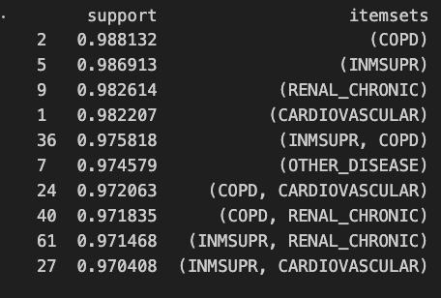
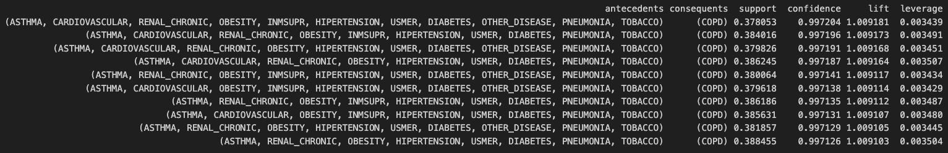
Observations and Insights

Slide 25
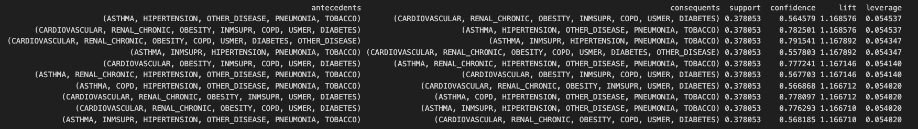
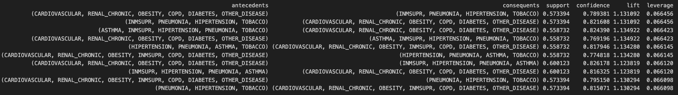
Observations and Insights

Slide 26
Models Training And Evaluation
Model | Accurancy
Naïve Bayes | 85.78%
KNN(Sklearn) | 93.04%
Linear Regression | Mse=0.1099219394433318
Logistic Regression | 87.66%
KNN(PYSpark) | 92.79%

Slide 27
Unsuccessful Trials
1- Tried to remove 3 correlated features before classification : Gate_location , Departure_Delay_in_Minutes , Ease_of_Online_booking but R-squared , mse of linear regression has dropped , also tried to remove the first 2 of them but got same results .

Slide 28
Thanks

